Slide 1
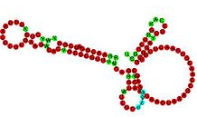

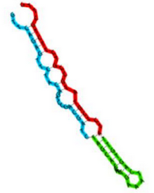



Magnaporthe oryzae small-RNA sequencing

Slide 2




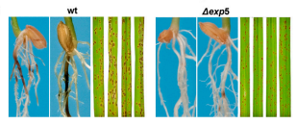
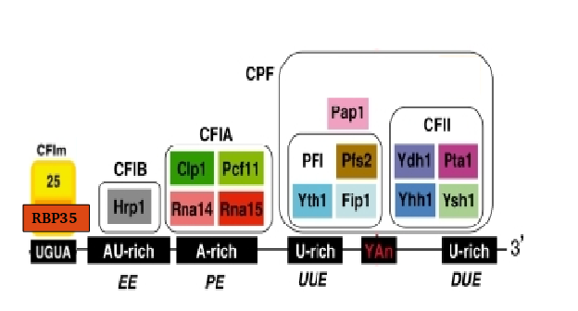
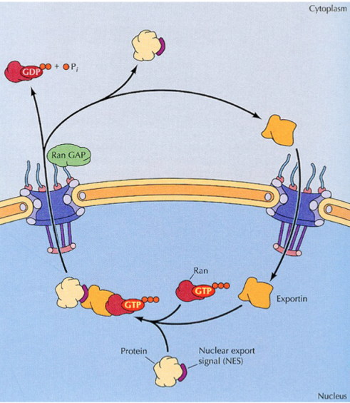
Introduction
RBP35
EXP5

Slide 3
Introduction – RBP35
We performed a poly(A) specific RNA-seq
Alternative polyadenylation is altered in ∆rbp35 in 25% of genes, belonging to specific functional groups
UTR are usually shortened in ∆rbp35
∆rbp35 probably binds to UGUA motif
….(previous work)

Slide 4
Introduction – EXP5
In yeast, involved in nuclear import and export of several proteins, and required for re-export of mature tRNAs after their retrograde import from the cytoplasm
In mammals also mediates the nuclear export of micro-RNA precursors, and double-strand RNA bearing proteins

Slide 5
Introduction – purposes
In order to elucidate a role for EXP5 in M.oryzae, and considering its role in smallRNA export in mammals, we performed a smallRNA sequencing.
We also included the ∆rbp35 mutant in the pool

Slide 6
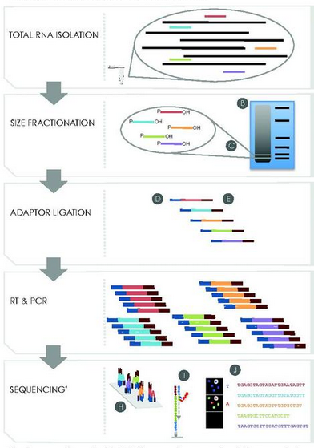
Small RNA library preparation and sequencing

Slide 7
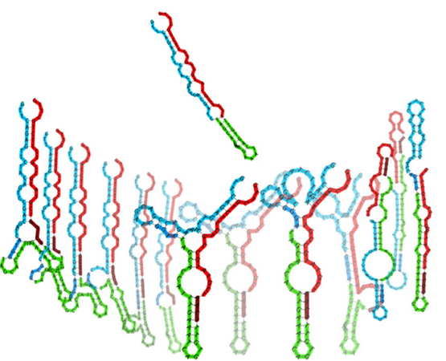
Standard smallRNA-seq adapters have been shown to be biased for certain RNA structures

Slide 8


Our library was prepared with HD adapters (adriana in england)
Regular smallRNA-seq
sequencing
HD smallRNA-seq
X256 combinations
sequencing

Slide 9
Sequencing resume
sample | total reads | After filtering* | % filtered reads | Unique reads
WT_3 | 14168509 | 11826616 | 16.53% | 10.71%
WT_2 | 21412622 | 17398315 | 18.75% | 8.97%
WT_1 | 13826696 | 10577152 | 23.50% | 10.09%
∆rbp35 _3 | 32233131 | 21309230 | 33.89% | 10.86%
∆rbp35 _2 | 25965551 | 22122147 | 14.80% | 10.61%
∆rbp35 _1 | 14107800 | 7261472 | 48.53% | 11.50%
∆exp5 _3 | 16606918 | 12293728 | 25.97% | 10.11%
∆exp5 _2 | 39423030 | 37346923 | 5.27% | 7.03%
∆exp5 _1 | 25580902 | 23662841 | 7.50% | 8.29%
* No 3’ adapter found, too short after trimming (<18) or low quality

Slide 10
∆exp5_1 looks uncorrelated with the other two replicates

Slide 11


Adapters contamination is variable

Slide 12
Insert size is between 18-25 bp

Slide 13
There is an overall U preference as 1st nucleotide

Slide 14
Bias of adapter preference between WT and mutants

Slide 15
More than 70% of reads do not aligned perfectly on the genome

Slide 16
∆rbp35 aligns a little more, ∆exp5 slightly less

Slide 17
∆rbp35 aligns a little more, ∆exp5 slightly less

Slide 18
∆rbp35 produces more reads from cDNA

Slide 19
Transposable elements represent most of the expression

Slide 20
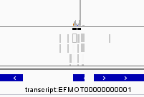

Three approaches to identify changes
Genome clusters detection
Transcriptome clusters
detection
Single read analysis
GGCAACGTGCCTGAGTGGTTAAA
ACGACCATACCCACTG
TCCGGTATGGTGTAGGGGTTAGCATAC
Cluster found!
. . .
Cluster found!
DIFFERENTIAL EXPRESSION

Slide 21
Most of genome cluster loci (3572) come from protein transcripts

Slide 22
In ∆exp5, a lot of protein-coding related clusters are down regulated, and many transposable elements related clusters are up regulated
Total 47
Total 30

Slide 23
In ∆exp5, tRNA-lys is downregulated, retro5 clusters are upregulated, and several protein-coding related clusters:
ncRNA
tRNA-lys
Protein coding
MGG_00246 | NADP-dependent alcohol dehydrogenase 6
MGG_12760 | Anthranilate synthase component I; Anthranilate synthase component I, variant
MGG_10911 | Cupin domain-containing protein
MGG_06868 | Acetolactate synthase catalytic subunit
MGG_02980 | DNA-(Apurinic or apyrimidinic site) lyase 2
MGG_10912 | Mycocerosic acid synthase
MGG_01704 | Vacuolar protein-sorting-associated protein 36
MGG_08072 | Cholesterol oxidase
MGG_10315 | Hydrophobin-like protein MPG1
MGG_01655 | Copper radical oxidase
MGG_15185 | Agglutinin isolectin 1
MGG_05160 | Hydrolase
MGG_08641 | Pre-mRNA-splicing factor CWC2
MGG_02439 | Oxidoreductase
MGG_14897 | Polyketide synthase
MGG_07779 | Quinate permease
MGG_03670 | Subtilisin-like proteinase Spm1

Slide 24
In ∆exp5, retro5 clusters are upregulated, and several protein-coding related clusters:
Transposable element
17 retro5
Protein coding
MGG_08059 | Putative uncharacterized protein
MGG_07571 | LysM domain-containing protein
MGG_11176 | Putative uncharacterized protein
MGG_08022 | Putative uncharacterized protein
MGG_18082 | Putative uncharacterized protein
MGG_17196 | Putative uncharacterized protein
MGG_06654 | Putative uncharacterized protein
MGG_01516 | Putative uncharacterized protein

Slide 25
In ∆rbp35, a lot of transposable elements related clusters are down regulated, and many ncRNA related clusters are up regulated
Total 492
Total 407

Slide 26
In ∆rbp35, a lot of transposable elements (mainly MAGGY and INAGO 1/2) related clusters are down regulated
Protein coding
Transposable element
116 MAGGY
64 INAGO 1
31 INAGO 2
2 Pyret
1 POT2
1 MGRL-3
MGG_17324 | Putative uncharacterized protein |  | PHI:879
MGG_16535 | Putative uncharacterized protein |  | PHI:871
MGG_04538 | Putative uncharacterized protein |  | PHI:786
MGG_15019 | Peroxisomal copper amine oxidase |  | PHI:2171
MGG_06368 | AGC/PKA protein kinase |  | PHI:2162
MGG_12865 | Putative uncharacterized protein |  | PHI:2131
MGG_05078 | Potassium/sodium efflux P-type ATPase |  | PHI:2098
MGG_03580 | Cysteine protease ATG4 | ATG4 | PHI:2072
MGG_00611 | 2OG-Fe(II) oxygenase
MGG_12839 | Actin cytoskeleton-regulatory complex protein PAN1
MGG_15020 | Amino acid permease
MGG_12760 | Anthranilate synthase component I; Anthranilate synthase component I, variant
MGG_04855 | ATP-dependent bile acid permease
MGG_04179 | ATP-dependent RNA helicase DBP10 | DBP10
MGG_06335 | Calpain-7
MGG_06327 | Candidapepsin-3
MGG_04407 | Cation efflux family protein
MGG_08072 | Cholesterol oxidase
MGG_09930 | Chromodomain-helicase-DNA-binding protein 3
MGG_07098 | Condensin subunit
MGG_06470 | DNA repair helicase RAD25
MGG_02804 | DNA repair protein rad16

Slide 27
Adriana’s Mo-3 is down-regulated in ∆rbp35, but not in ∆exp5 ;)
∆ T
WT T
∆ N
WT N
∆ C
WT C
200
150
100
90
75
45
27
LTR
LTR
Viral capsid
domain
Zinc
finger
Retroviral
Aspartyl
protease
Reverse
Transcriptase
domain
Ribonuclease
H-like
domain
Chromo
domain
MAGGY RETRONTRASPONSON

Slide 28
In ∆rbp35, many ncRNA related clusters are up regulated
ncRNA
tRNA-Ala tRNA-Arg tRNA-Asn tRNA-Asp tRNA-Cys tRNA-Gln tRNA-Gly tRNA-His tRNA-Ile tRNA-Leu tRNA-Lys tRNA-Met tRNA-Phe tRNA-Pro tRNA-Pseudo tRNA-Ser tRNA-Thr tRNA-Trp tRNA-Undet tRNA-Val U6 A. fumigatus snoRNA Afu_300 A. fumigatus snoRNA Afu_335
Transposable element
17 MINE
7 Pyret
1 MGRL-3
1 MGL
Protein coding
MGG_04582 | Putative uncharacterized protein
MGG_02961 | Anucleate primary sterigmata protein A
MGG_11454 | Vacuolar calcium ion transporter
MGG_02074 | Potassium/sodium efflux P-type ATPase
MGG_00454 | Putative uncharacterized protein
MGG_00865 | 1,3-beta-glucan synthase component FKS1
MGG_03372 | 40S ribosomal protein S20
MGG_06657 | 40S ribosomal protein S25
MGG_02392 | 40S ribosomal protein S30
MGG_02747 | 40S ribosomal protein S4-A
MGG_06658 | 40S ribosomal protein S5
MGG_06712 | 5-methyltetrahydropteroyltriglutamate-homocysteine S-methyltransferase
MGG_12403 | 5'-3' exoribonuclease 1
MGG_09194 | 60S ribosomal protein L17
MGG_04484 | 60S ribosomal protein L18
MGG_04582 | Putative uncharacterized protein

Slide 29
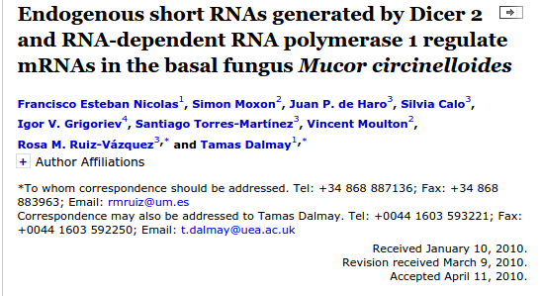
4 classes of siRNAs were discovered in Mucor
Dicer1
Dicer2
RdP1
Rdp2

Slide 30
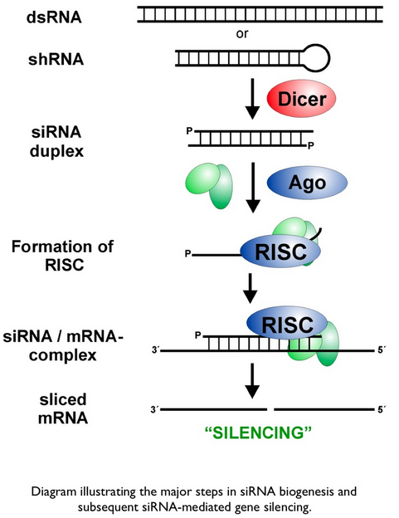
This is how siRNAs supposedly work…
RdP1/2

Slide 31
647 siRNAs from the three strains were identified, mostly from protein-coding genes
Including 17 PHI genes

Slide 32
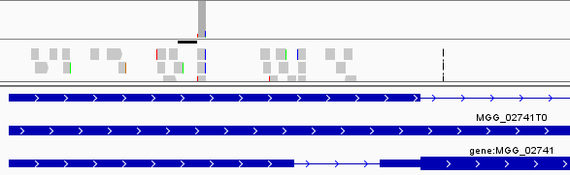
RBP35 itself has a siRNA in its 5’UTR, before its “famous” intron
Unlike RBP35, most of siRNAs identified have a SNP, possibly a
post transcriptional modification (or some kind of error of mine ;)
They are also very short, 18-20 bp…..:-/

Slide 33
27 and 134 siRNA are differentially expressed in ∆exp5 and ∆rbp35, respectively

Slide 34
∆rbp35 produces shorter smallRNA

Slide 35
∆rbp35 produces smallRNA with 1st nucleotide U-preference

Slide 36
A lot of differentially expressed unique reads are of unknown origin

Slide 37
Is RBP35 involved in alternative splicing?

Slide 38
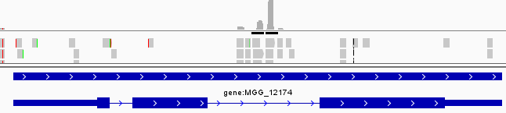
Nothing notable about Adriana’s Mo-2
Probably, an intronic snoRNA

Slide 39
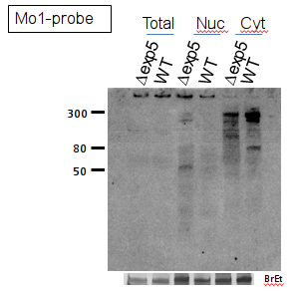
Adriana’s Mo-1 is belongs to an unknown, but conserved RNA class. Anyway, they don’t seem to be affected by the two mutants
Large polyadenylated transcript
(precursor?)
Aspartyl-tRNA synthase
AAAAA…
Mo-1
OTHER GENES:
Pre-RNA processing factor 39
GET1
Nuclear pore complex protein Nup107
Serine hydroxymethyltransferase
A subunit of the AP-1 complex
A extracellular serine-threonine rich protein
….
Similar structure conserved in all pezyzozyma clade!

Slide 40
Next steps…
Find out what all those unknown reads are
Classify better siRNAs and their genes, is the situation conserved? (mucor)
Analyze the transcriptome as well
Mix the results with polyadenylation study
Reads shortening and 1st nucleotide preference in rbp35 is related with anything?
Redo the analysis on GUY11 genome
…

